Slide 1
CS 4701 AI Practicum
Web-based Game
Unbeatable AI Tetris
Xi He (xh243)
Yanjia Li (yl2493)

Slide 2

Game Demo
AI show
Speed adjustment
competition against AI agent
Arcade mode
Easy, hard, extremely hard
free mode
CS4701 Artificial Intelligence Practicum

Slide 3
Methodology and Algorithm
Evaluation function
Particle Swarm Optimization
CS4701 Artificial Intelligence Practicum

Slide 4
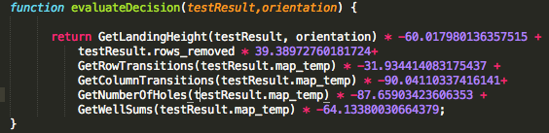
Evaluation Function
Features:
f(move)=w1*f1+w2*f2+w3*f3+w4*f4+w5*f4+w6*f6
f1 is landing height
f2 is the rows will be removed
f3 is row transitions
f5 is number of holes
f5 is well sums
CS4701 Artificial Intelligence Practicum

Slide 5
Particle Swarm Optimization
p[m].v[i]=
para1 x p[m].v[i]+
para2 x ( p[m].pBestWeight[i] - p[m].weight[i] ) x Rand+
para3 x ( gBestWeight[i] - p[m].weight[i] ) x Rand
parameters
para1,2,3: velocity changing rate = 0.6571, 1.6319, 0.6239
number of particles: 63
Rounds
75 rounds
Best weights
CS4701 Artificial Intelligence Practicum

Slide 6
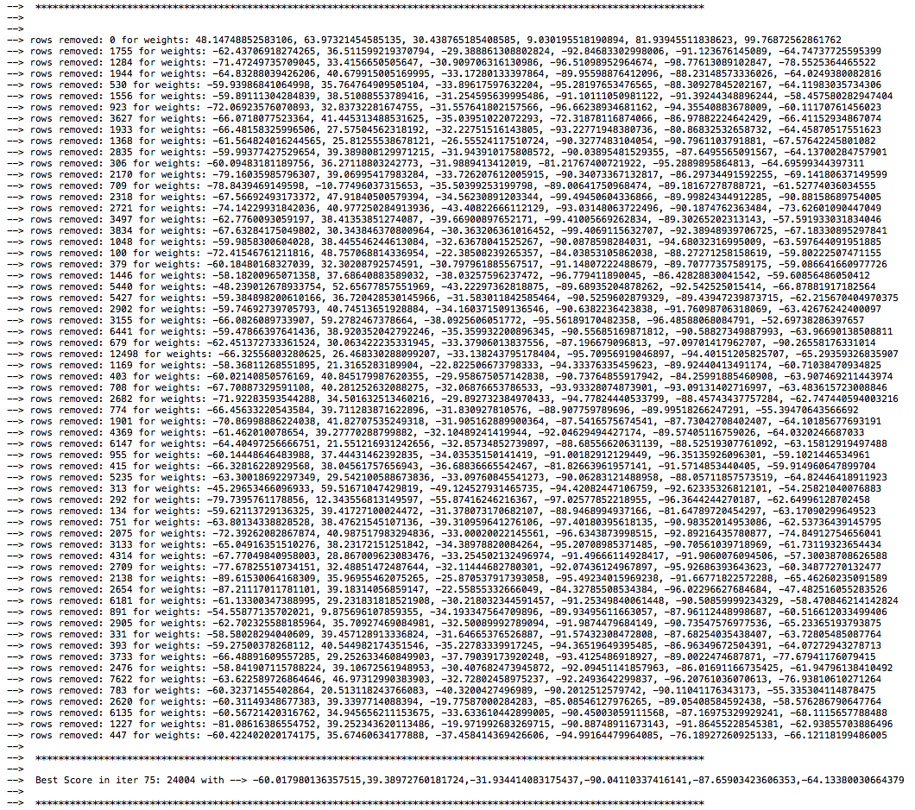
Optimization
Log of the 75th round
The best weights found in the entire 75 rounds
w1 = -60.017980136357515
w2 = 39.38972760181724
w3 = -31.934414083175437
w4 = -90.04110337416141
w5 = -87.65903423606353
w6 = -64.13380030664379
CS4701 Artificial Intelligence Practicum

Slide 7
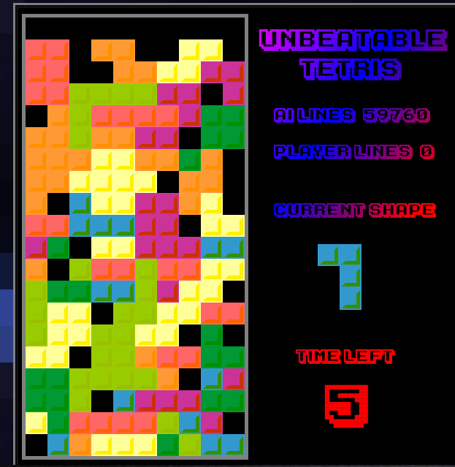
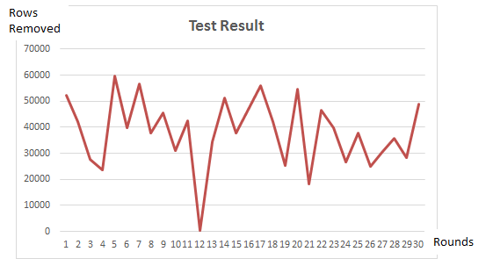
Testing Result
75 games rounds for each player (63 players)
Best: 59760 rows removed
Worst: 229 rows removed
CS4701 Artificial Intelligence Practicum

Slide 8
Conclusion
CS4701 Artificial Intelligence Practicum

Slide 9
Questions?
CS4701 Artificial Intelligence Practicum

